Slide 1


STA490 ICU
Pod C
Dec 2, 2021
ICU ADMISSION
RISK SCORE ANALYSIS
...
Alex Kim
Siqi Zheng (Tim)
Rebecca Chen
Rain (Run) Wu
Exploratory Data Analysis

Slide 2


Table of Content
Project Overview
Data Cleaning
Preliminary Insights
Does basic patient information affect ICU Admission?
How does time affect Medical Measurements?
Does the last medical measurement record help to predict ICU Admission?
Limitation & Challenges
Next Step
...
Notes:
We will first introduce the context of our project, then briefly go over the data cleaning steps we have done to make more sense of the data. For the preliminary insights section we have listed three guiding questions to help us better understand the data. We will then end our presentation with some limitations and next steps.

Slide 3
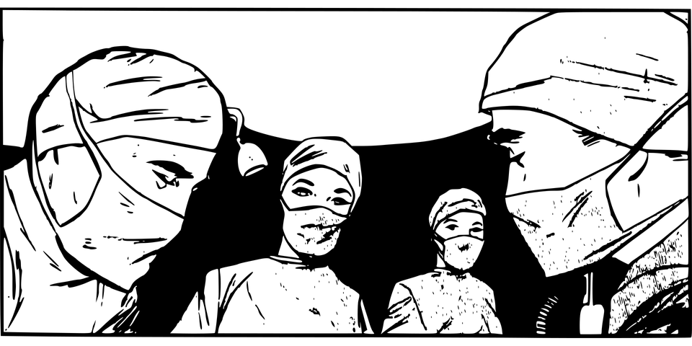
Part 1:
Project Overview
What is our purpose?
...
What is ICU?
What is risk score and why do we care?
Our main research questions

Slide 4


What is ICU?
ICU stands for Intensive Care unit
Last minute resort to keep patients alive
...
What is Risk Score?
Numeric rating of patient’s likelihood of need for intensive care
Notes:
What is ICU?
ICU stands for Intensive Care Unit, and it is used as a last resort method to keep patients alive when their body fails to do so.
In an ideal world, all patients in need of an ICU would receive one, but the limited resources available in hospitals calls for an alternative method, one which uses risk scoring.
What is Risk score?
Simply put, risk score rates a patient’s need for intensive care based on a numeric score, considering factors such as the patient's current health, hospital’s budget and the time required to treat the patient.

Slide 5


Main Research Questions
...
...
Is there an optimal risk score that helps identify subjects with an increased risk of needing intensive care (ICU Admission)?
Do all components of the data (Patient Information & Medical Measurement) contribute equally to risk score construction?
Notes:
So what is our main research question?
The main goal of our project is to determine an optimal risk score that best predicts the patient’s need for intensive care based on a simulated data of 900 patients.
Furthermore, we want to explore whether all components of the patient’s data contribute equally to the risk score construction via data visualization.

Slide 6





Part 2: Data Cleaning
Variable Introduction
Data Manipulation
Table 1: datevent
id | Patient ID
Female (0/1) | Gender of the patient
Age | Age of the patient
Event Time (Days) | Number of days the patient stayed in hospital (Before admitted into ICU/Left hospital)
Status (0/1) | Whether patient was admitted to ICU/Left hospital
Notes:
Our EDA Report is based on the data of 900 patients. There are two datasets where the first one contains patient information data and the second one contains logs for patient health condition measurements. All the variables in the first dataset are listed in table 1,such as patient id, age, gender and the duration of stay. For variables Female and Status, they are indicated by a binary value and we converted them from a numeric variable to a factor for a more convenient data analysis, . It is worth noting that the status represents whether the patient is admitted to the ICU at the end of their stay in the hospital. Hence, the status is the main response variable that we are interested in.

Slide 7








Part 2: Data Cleaning
Variable Introduction
Data Manipulation
Table 2: datlog
id | Patient ID
Time | Time when the record is taken
Respiration Rate | Number of breaths per minute
Oxygen Saturation | Blood oxygen levels in percentages
Air (0/1) | Whether the patient received enough oxygen
Blood Pressure | Systolic blood pressure
Pulse Rate | Heart rate per minute
Alert (0/1) | Level of Consciousness. 0 - unconscious， 1 - conscious
Temperature | Body temperature in degree celsius
NEWS Score | An existing risk measurement used by hospitals.
Notes:
The second data set consists of the records every four hours as rows. Table 2 gives some descriptions of the clinical metrics that were measured. For both binary variables Alert and Air, 0 indicates a bad situation. For example, in Alert ,0 implies that the patient lost consciousness and 0 in Air implies that the patient lacks oxygen and needs supplemental oxygen to support breathing.

Slide 8
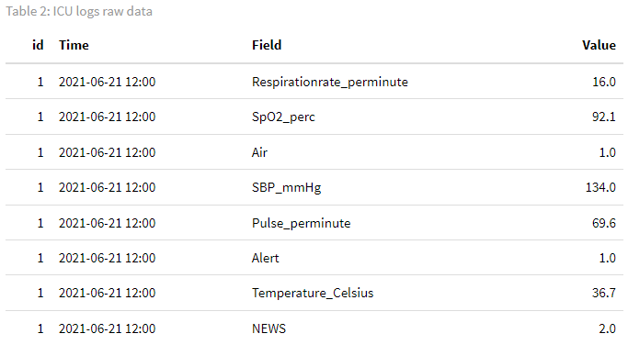
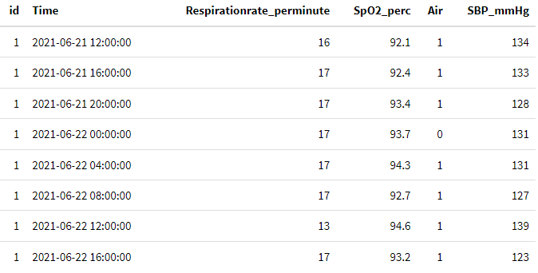
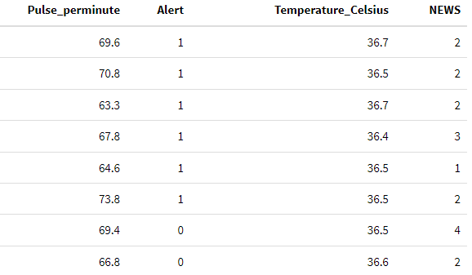
Part 2: Data Cleaning
Variable Introduction
Data Manipulation
Step 1: Rearrange the data
Notes:
The biggest problem of the initial data was that there were too many rows. All measurements are recorded under the same column.Because of the way that the data was structured, there were eight rows per each timestamp, one for each field. To reduce the number of rows, we have created a separate column for each field. With this, each row would represent all the records of one single timestamp. That’s how our data set looks after rearrangement.

Slide 9
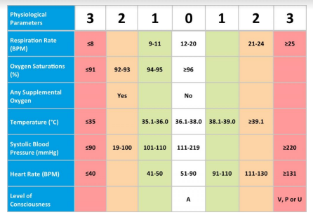
Part 2: Data Cleaning
Variable Introduction
Data Manipulation
Dealing with the missing values
Step 2:
Calculate the NEWS score
Fill the missing value with previous record from same patient
Or next record if first record is Null
NA
NA
Notes:
There are no null values in the first Dataset, so no action was done to it. However, in the second dataset, there is a patient has only one record but was missing NEWS score, so we calculated the NEWS score based on the left scale. For other missing records in the second dataset , they have been replaced to its previous value. This decision was made knowing that the data collects patient records every four hours.Given how frequently records are updated, there is a great chance that the missing value will likely be identical to its previous observation unless a serious event has occurred.

Slide 10
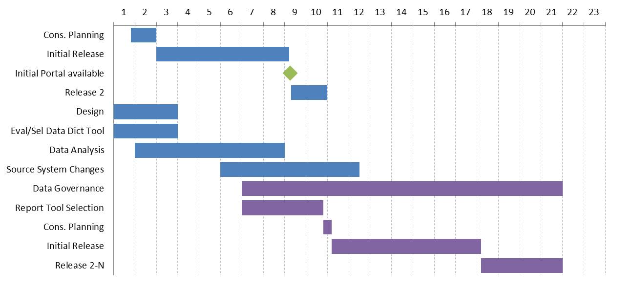
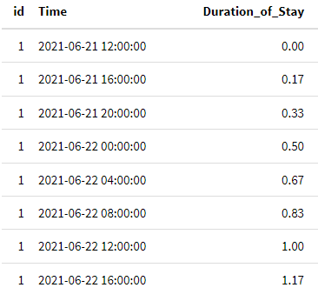

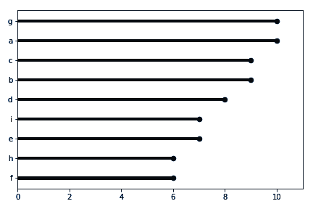
Part 2: Data Cleaning
Variable Introduction
Data Manipulation
Add a new variable for time measurement
Step 3:
Notes:
Since the event time is recorded in days in the first data set, we added a new variable for time measurement in the second dataset called Duration of Stay which indicates when the record was taken in days. For example, the first record was always taken at Duration of Stay 0 and the second record was taken at Duration of Stay 0.17. Since the records were taken every 4 hours which is 0.17 days. Hence, the Duration of Stay of the last record is always the same as the patient’s event time in the first dataset.

Slide 11

Part 3: Preliminary Insights
Visualizing the data
...
Does basic patient information affect ICU Admission?
How does time affect Medical Measurements?
Does the last medical measurement record affect ICU Admission?
Notes:
Here comes to the preliminary insights part. I am going to discuss the first question, does basic patient information affect ICU Admission.

Slide 12
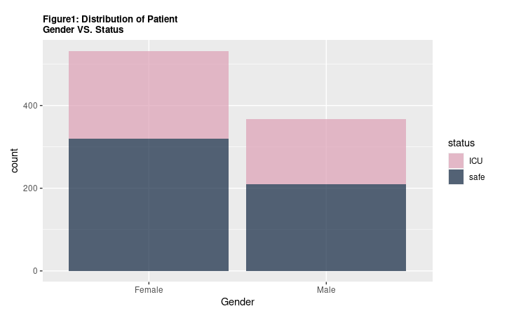
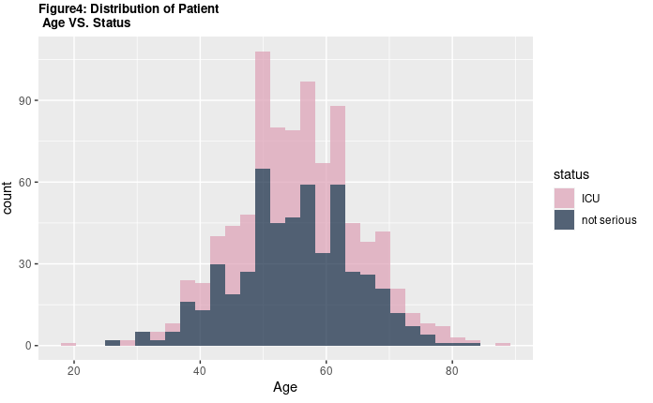
Question 1:
Does Basic Patient Information affect ICU Admission?
The proportions are similar across groups
Figure1.1: Distribution of Patient Gender VS. Status
Figure1.2: Distribution of Patient Age VS. Status
ICU
ICU
Not Serious
Not Serious
Notes:
The stacked bar graph shows that there are more females in the sample patient data. However, the proportion of females admitted to ICU is similar to the proportion of males, both a little bit less than 50%.The right graph compares the distribution for patient age between non-serious patients and ICU patients.We notice that the histograms roughly have the same distribution, both are centred around the age group of 50-60 years old. Overall, it seems that basic patient information like age and gender did not have a large effect on ICU Admission.

Slide 13
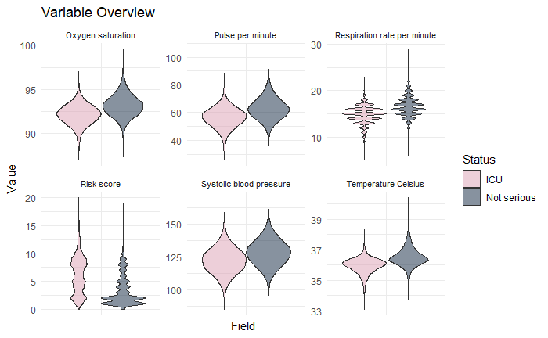
Question 1 Cont.
All of the Numerical Medical Measurements follow Normal Distribution except for NEWS Score
Figure1.3: Distribution of Numerical Medical Measurements
NEWS
Notes:
Figure 1.3 serves to illustrate the distributions followed by individual numerical medical measurements. From this we see that:
most of these variables follow a normal distribution except for the risk score. This is possibly due to the fact that news/risk score is a calculated score based on 7 other measurements and not a standard medical measurement of a patient’s current status.
respiration rate illustrates a rather odd normal distribution compared to rest of the measurements following a normal distribution. This is because respiration rate is not continuous (it consists of integer values), but it can still be approximated with a normal distribution

Slide 14
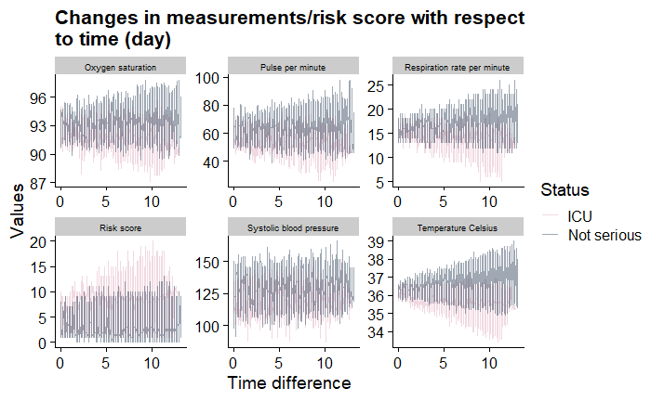
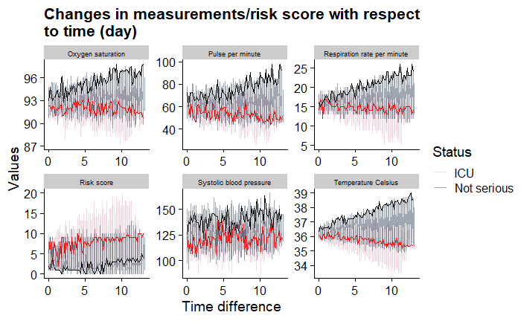
Question 2:
How does time affect indicator variables?
Variances of All Numerical Measurements Increase as Time Progresses
Figure2.1: Changes in numerical measurements/risk score with respect to time (day)
Notes:
How does time affect indicator variables and risk score? Since it is challenging to visualize changes in all variables with respect to days for all 900 patients, 40 random samples are taken from the dataset and the variable vs time line graphs are shown above. Notably, the pink lines are patients with ICU status while grey lines are patients without serious event. The single red line indicates a random patient with status ICU while the single black line indicates a random patient without serious status. The most significant pattern is that the measurements tend to fluctuate more when the number of days increases. That is to say, it seems that the time series is multiplicative and the extreme values tend to occur as the time progresses. This suggests that we may be able to implement time series models in the analysis since there may be a pattern for the top 3 graphs and the bottom right one. In addition, it is clear that except for the risk scores, most measurements are higher for patients without serious status, which can be seen from the random patients’ trajectories. In particular, patients admitted in ICU tend to reach extreme low measurements compared to non-ICU patients after 5 days.

Slide 15
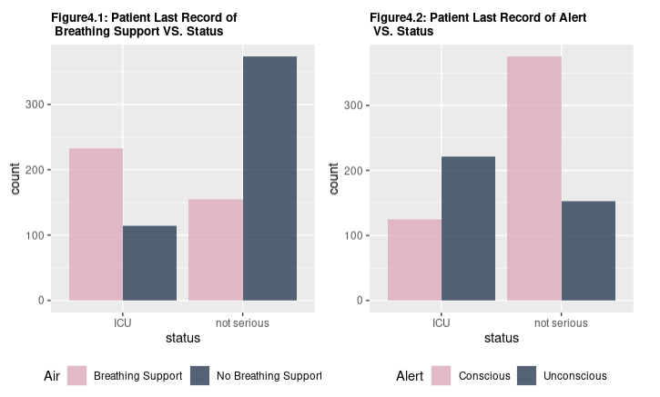
Question 3:
Does the last medical measurement record affect ICU Admission?
3
3
Notes:
In this section, we will be exploring the relationship between each last measured patient health metrics and the patient’s status. Since status is recorded when each patient has their last measurement, either before ICU admission or before they leave the hospital safely.
From observing the graphs, we noticed that for patients who are admitted into ICU, most of them need breathing support and were unconscious before they were admitted into the ICU. On the other hand, most of the patients who are safe do not need breathing support and are conscious for their last record before leaving the hospital. This observation implies potential correlation between a patient’s Air/Alert measurement and whether the patient should be admitted into the ICU.

Slide 16
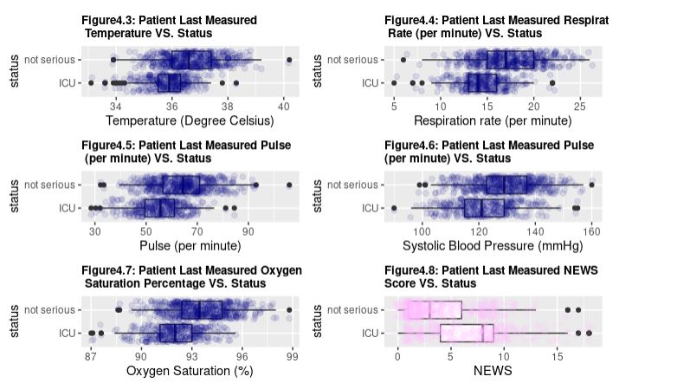
Question 3 Cont.
All Last Record of Numerical Medical Measurements are Lower for Patients in Need for Intensive Care except for NEWS Score
3
3
3
3
3
3
Notes:
From observing this set of graphs, we noticed a difference in the five purple physiological measurements of each patient’s last record before they left the hospital or were admitted into the ICU. Compared to safe patients, a typical patient getting admitted into ICU has a relatively higher body temperature, respiration rate, pulse, blood pressure, and oxygen saturation for their last record. We suggest using each patient’s last measured record to calculate the risk score. And it naturally makes more sense to check a patient’s most recent measurement when deciding whether to admit them into the ICU.
The typical safe patient’s last-recorded NEWS score is significantly lower than patients who are admitted into the ICU. We are expecting some correlation between the eight measurements and patient status thus contributing to the patient’s risk score calculation.

Slide 17
Question 3Cont.
All Last Record of Numerical Medical Measurements are Lower for Patients in Need for Intensive Care except for NEWS Score
3
3
3
3
3
3
Notes:
Since one of our research goals is to find a better risk score measurement than the existing NEWS score. One suggestion is that the range of each measurement can be more specific than the given NEWS score formula. For example, almost all ICU Patients have temperature ranging from around 35-37.5 in their last measured record but the temperature range is considered to be safe in NEWS calculation)

Slide 18
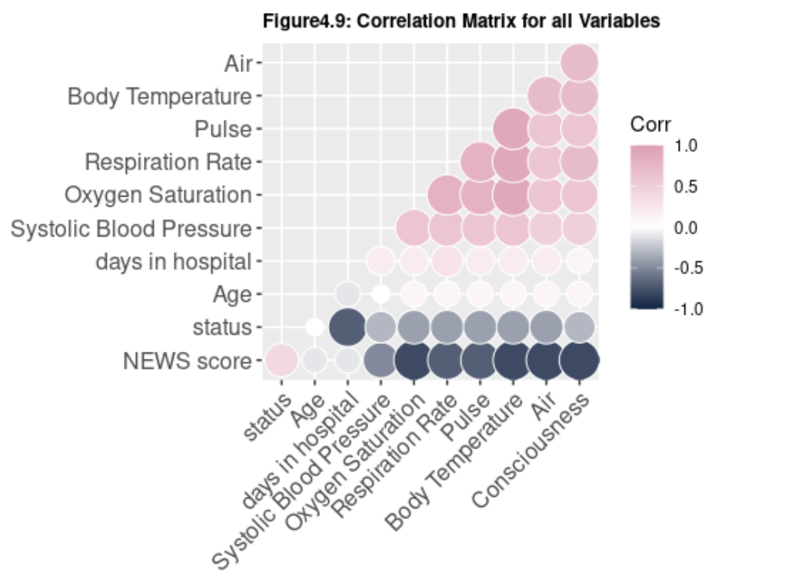
Question 3 Cont.
All Last Record of Numerical Medical Measurements are Negatively Correlated with Likelihood of Patient ICU Admission
Note:
Multicollinearity Exists
Notes:
This is a correlation matrix showing whether there is correlation among the variables given. The size of the circles in each cell indicate the strength of the correlation while pink indicates a positive correlation and black indicates a negative correlation. From observing the last two rows of the matrix, we know there are negative correlation between days in hospital, blood pressure, oxygen saturation, respiration rate, pulse, temperature, breathing support, consciousness and the patient’s status, which means that having higher values in those measurements implies lower likelihood of ICU admission. In the bottom left corner, we see a positive correlation between patient NEWS score and patient’s status. In other words, a higher NEWs score implies higher likelihood of ICU admission for the patient. Note that in the data, many features are strongly correlated with each other. Especially since the NEWS score is calculated based on the other measurements, there is multicollinearity in the data. Using variable inflation factor (VIF) to eliminate these correlated features is prudent in later analysis.

Slide 19

LIMITATIONS & CHALLENGES
A relatively large portion of missing values
The measurements are recorded every 4 hours i.e. the measurements are not taken continuously. This means we do not know what happened between 2 consecutive measurements.
Did not tell if the patient has recovered, has been transferred to another hospital or has passed away after leaving the hospital.
We carry the non-missing values from the past forward to replace the missing values
The design of risk score matrix - explanatory vs predictive model?
Notes:
The original datasets have some limitations in terms of the scope of the data. First, there is a relatively large portion of missing values, which forces us to make some assumptions about missing values. Second, the measurements are recorded every 4 hours i.e. the measurements are not taken continuously. This means we do not know what happened between 2 consecutive measurements within the 4 hrs interval. Furthermore, even though the dataset reports the number of days the patient stays in the hospital, the data do not tell if the patient has recovered, has been transferred to another hospital or has passed away after leaving the hospital. This lack of details is an obstacle for us to draw clinical conclusions.
In the data cleaning process, we carry the non-missing values from the past forward to replace the missing values. This is a reasonable inference, but we are not sure if this is the most appropriate method in reality. Therefore, we may need more information about the actual process of data collection in the hospital. Finally, there is a trade-off between good explanatory model or an accurate predictive model for risk score matrix.

Slide 20



Part 5:
NEXT STEPS
...
Time Series model
Survivor Analysis
Machine Learning Model
Statistical
Models
Data Collection Process
Notes:
The next step is to build statistical models to pick the most significant predictors for suitable risk score calculation. Since we are working with longitudinal data, we suggest to consider
Time series model allows us to predict trends while incorporating time elements. It can be combined with logistic model to predict patient status given timed data
Survivor Analysis also works well with longitudinal data as it helps to analyze the expected duration of time until one event occurs.
As mentioned earlier, we can consider variable inflation factor (VIF) to eliminate multicollinearity in both methods.
Machine Learning Models are the go-to method when trying to make a prediction. Since one of the research goals is to find the optimum weight for each measurement when calculating risk score, we are allowed to tune the weight for variables in many of the machine learning models. Note that we will need to pay attention to the bias-variance tradeoff when training our models as the variance can be sensitive when it comes to the ICU data.
As mentioned earlier, all three models, we can consider setting more sensitive boundaries for risk score calculation.
On the other hand, as Tim has mentioned in the limitation section, more research can be conducted in terms of alternative data collection processes to ensure better data quality.

Slide 21

STA490 ICU Pod C
Thank you for listening :)
Any Questions?
?
Notes:
That’s the end of our presentation. Thank you so much for spending your precious time listening! Please feel free to ask any questions you may have

